Slide 1



Menopause Workshop
www.nataliemcivorpsychotherapy.co.uk
Surreypsychotherapist.natalie
Surreypsychotherapist.natalie
personcentredtherapies@gmail.com

Slide 2
Agenda
What is Menopause?
Symptoms
My Story
HRT
Lifestyle
Nutritional Support
Fitness/Movement
Grief and Loss
Talk Therapy

Slide 3
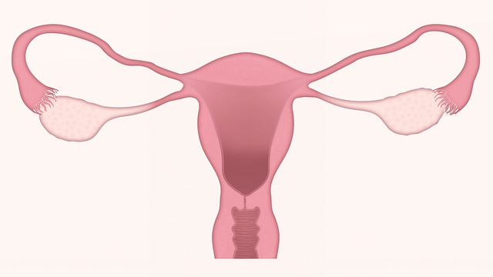
Meno - Pause
Estrogen
Progesterone
Testosterone

Slide 4
Estrogen, Progesterone and Testosterone protect different systems in the body
Brain
Heart
Bones
Urinary tract
Genital area
Skin

Slide 5
Stages of menopause
Peri-Menopause
Menopause
Post-Menopause
Premature Ovarian Insufficiency (POI)
Pre-Menopause
Surgical menopause

Slide 6
Peri Menopause
Average age 45years
Menopausal symptoms
Still having periods
Periods further or closer together. Irregular and heavier or lighter in flow.
Hormones levels fluctuate leading to symptoms of the menopause
Symptoms can occur for a few months or years then periods stop completely

Slide 7

What is the most common way of determining menopause or peri-menopause?
A blood test measuring the level of hormone called Follicle Stimulating Hormone (FSH)

Slide 8
Surgical Menopause
Ovaries removed
Radiotherapy to pelvic area as a treatment for cancer
Types of chemotherapy drugs that treat cancer
Medical or surgical treatment for endometriosis or premenstrual syndrome
Genetic and autoimmune factors

Slide 9
Premature Ovarian Insufficiency (POI)
Depression
Low self esteem
Grief and loss
Osteoporosis
Heart Disease

Slide 10
Did you know there are 34 symptoms?
Breast Pain Headache Joint Pain Burning Mouth Electric Shocks Hot Flushes Night Sweats Loss of Libido | Nausea & Digestive Troubles Dental Problems Muscle Tension Dry & Itchy Skin Tingling Vaginal Dryness Irregular Periods Anxiety
Fatigue Hair Loss Trouble Sleeping Dizziness Weight Gain Irritability Panic Disorder Difficulty Concentrating Depression | Bloating Allergies Brittle Nails Osteoporosis Irregular Heartbeat Changes In Body Odor Bladder Problems Mood swings Foggy brain

Slide 11
Loss of libido affects up to 40% of woman in their mid 40’s
Focus on non-coital intimacy
Natural lubricants or moisturisers
Pelvic floor exercise (Kegel)
Masturbation

Slide 12
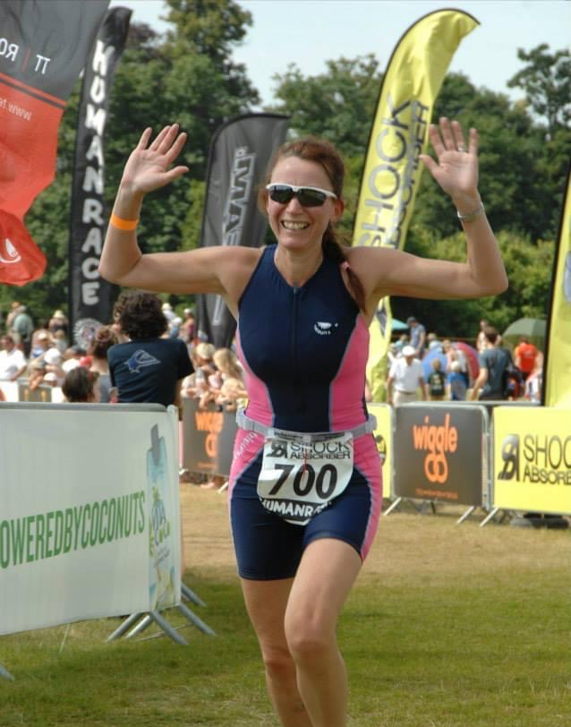
My Story
39yrs old
Physically fit
Big smile
Achieved PB in Triathlon
Alcohol dependent
Carer
Dying inside
(un-diagnosed peri-menopause)

Slide 13
BREAK

Slide 14
What is Hormone Replacement Therapy (HRT)?
A hormone treatment known as combined HRT:
Estrogen - either as a skin patch , a gel, a spray, or as a tablet you swallow. Termed 'body identical' it has the same molecular structure as the estrogen produced in the body. Derived from the yam root vegetable
Progesterone is needed alongside estrogen if you still have a uterus. It comes in a capsule you swallow
Testosterone – Available in a gel, cream or implant

Slide 15
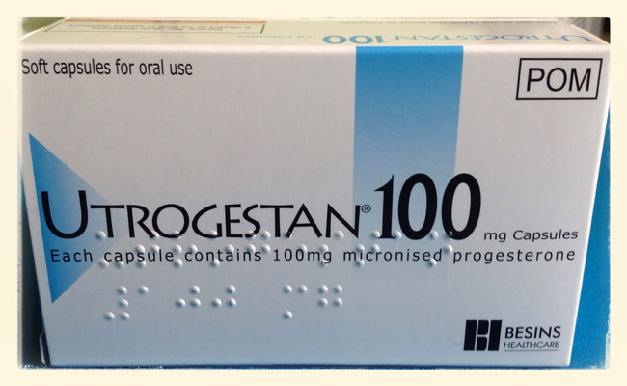
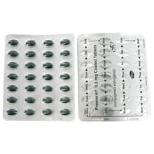
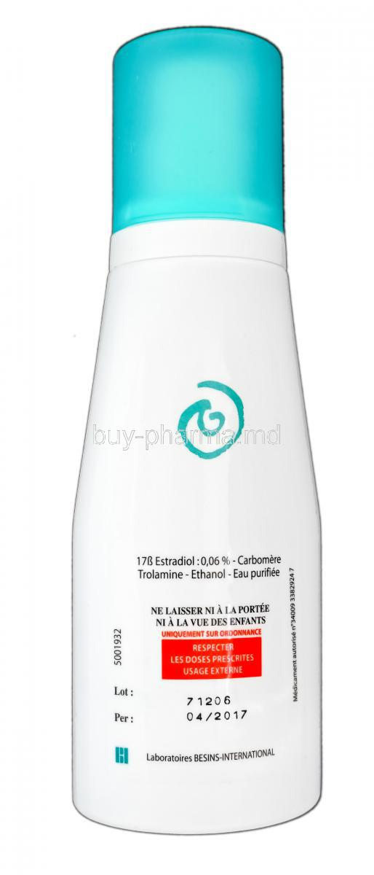
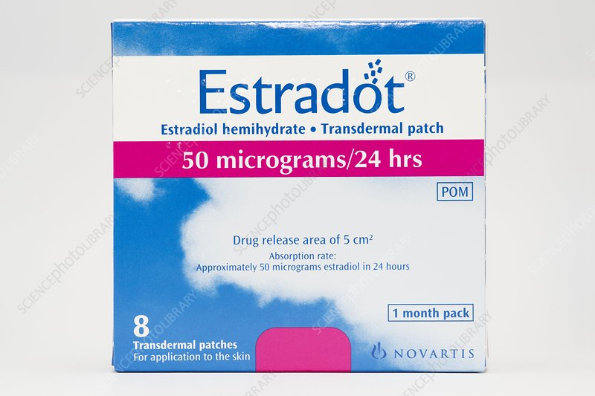
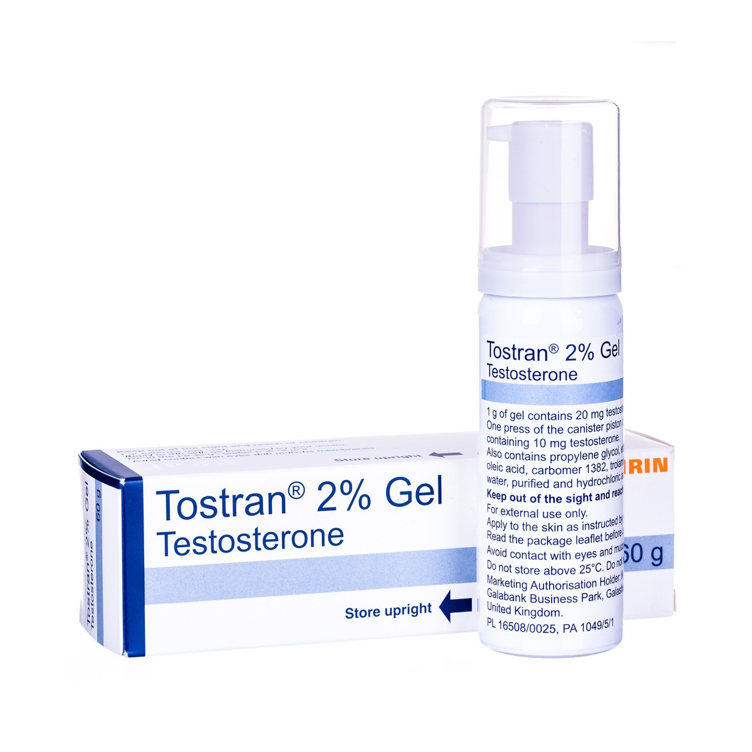
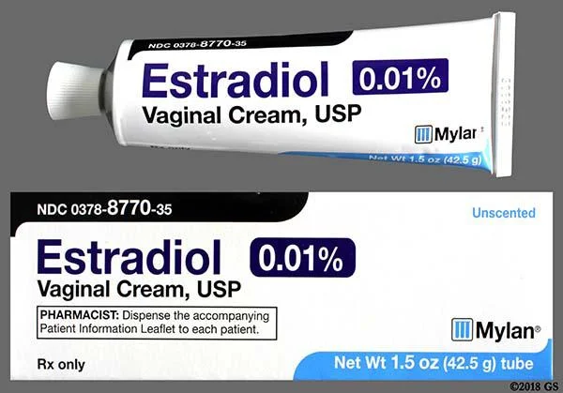
Bio-Identical Hormones

Slide 16
Hormone Replacement Therapy
BENEFITS
Reduced risk of developing heart disease, osteoporosis, diabetes, depression, dementia, bowl cancer and depression
Improved Symptoms
RISKS
Possible risk of developing breast cancer
Clotting – if you have a history of blood clots, liver disease or migraine
Breast tenderness of bleeding

Slide 17

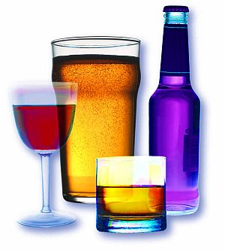
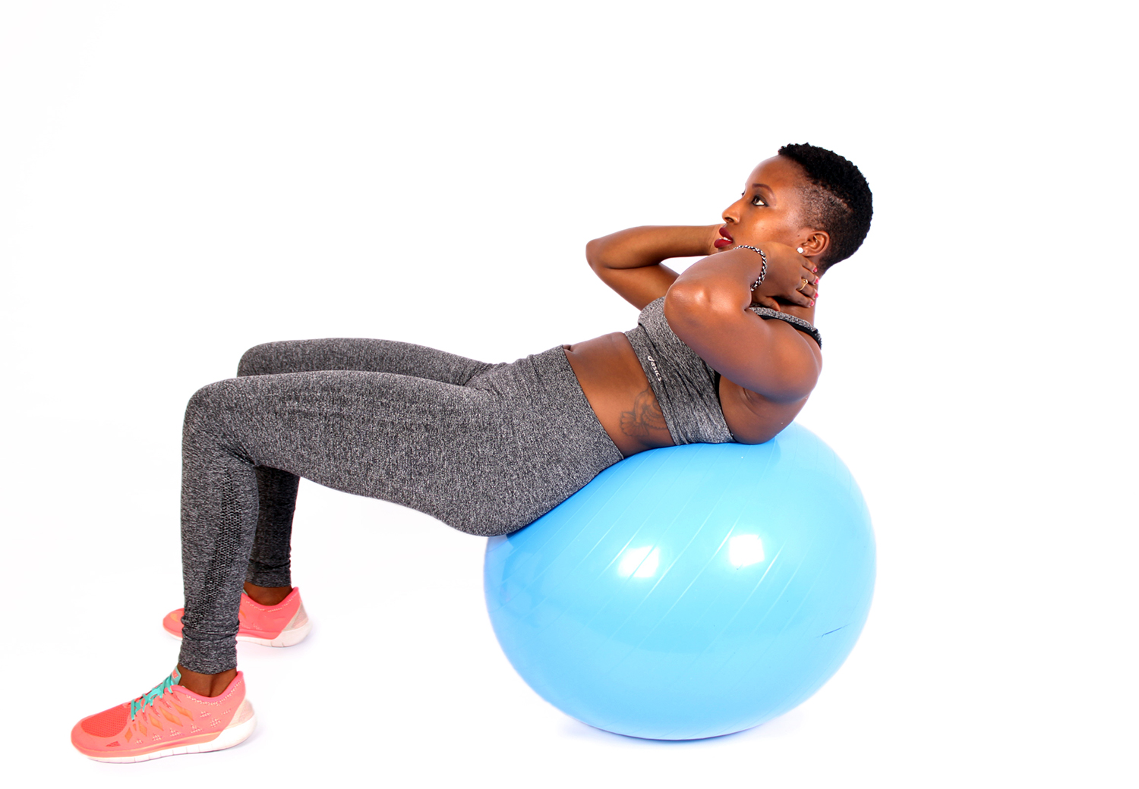
Improve low mood, mood swings and lack of motivation
Sleep hygiene
Reduce alcohol units
Increase exercise
Stop smoking
Stop smoking
Sleep hygiene
Reduce alcohol units
Increase exercise

Slide 18
Nutritional Support
Omega 3 – Oily fish/Avocado/Walnuts
Vitamin D – Sunlight/10mg supplement
Calcium – Milk/Almonds/Spinach/Cheese
B Vitamins- Eggs, Spinach, Shellfish, Offal
Iron and Magnesium – Apricots/Nuts/Legume/Red meat

Slide 19
Inflammatory foods to avoid
Sunflower oil
Processed Foods
Refined Carbohydrate

Slide 20

Fitness/Movement
Doing it is better than the mental torture we go through trying to make excuses not to do it

Slide 21
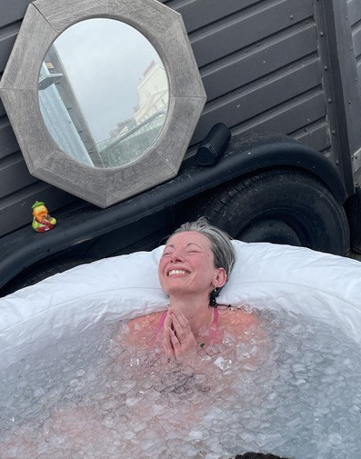
Cold Water Therapy
Stimulates the vegus nerve and regulates mood

Slide 22
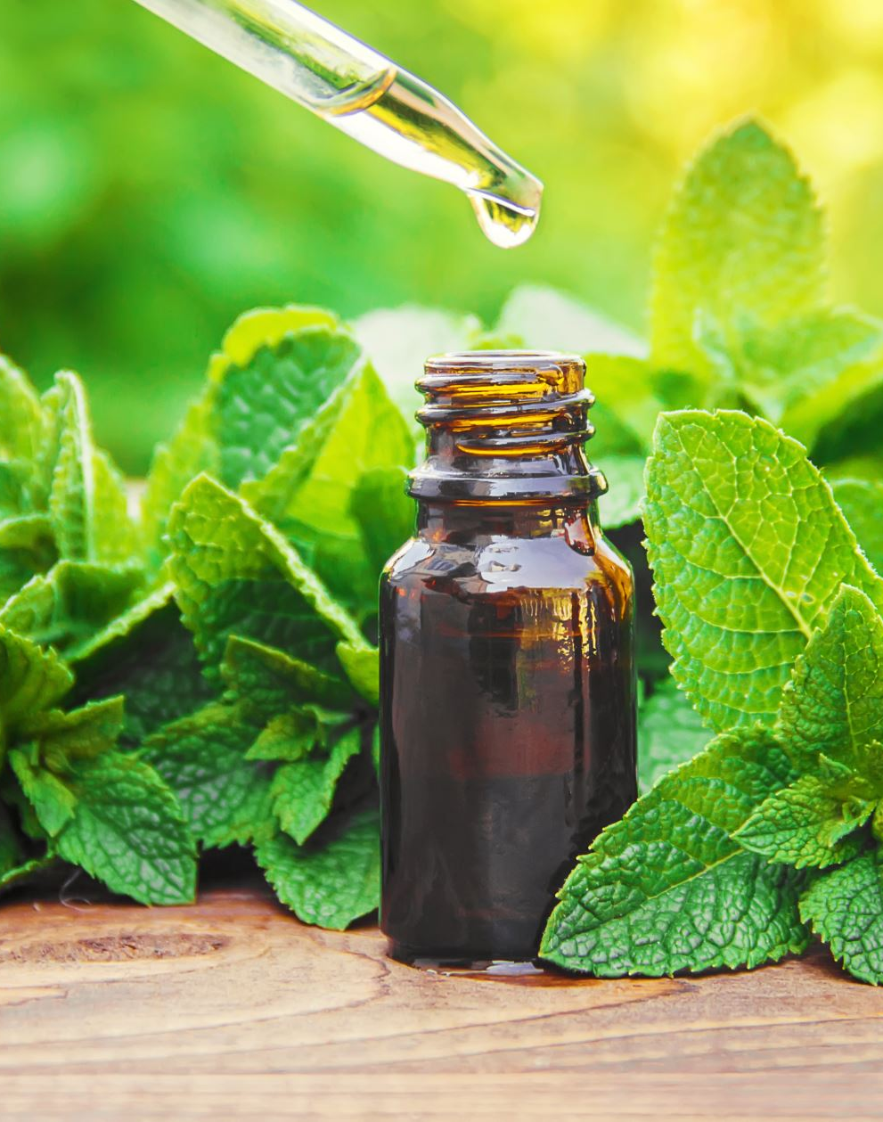
Holistic Approach
Medicinal Herbs
Complimentary Treatments
Herbal Supplements

Slide 23
Grief, Loss and Menopause
Isolation
Loss of Identity
Shame

Slide 24

‘This Too Shall Pass’

Slide 25
Talk Therapy and Menopause
Who am I?
Who did I used to be?
What do I want for the future?
Feel the loss
Embrace the fear

Slide 26
Summary
Menopause is an inevitable phase in every woman’s life
It’s defined by a woman not having a period in 12 months
Gradual decrease in reproductive hormones
Average age is 51yrs old
Perimenopause can last between 2 and 10yrs
Considered menopausal 1 year after final period
Relief and treatment; HRT, Holistic, Lifestyle
Psychological support

Slide 27
Online Resources
www.newsonhealth.co.uk
www.balance-menopause.com
www.menopausesupport.co.uk
www.megsmenopause.com
www.menoandme.com
www.nice.org.uk/guidance/ng23
www.nhs.uk/conditions/menopause
www.menopausematters.co.uk
www.lizearlewellbeing.com
www.channel4.com/programmes/davina-mccall-sex-myths-and-the-menopause

